Slide 1
NYC FLOOD RISK Exploration in Python
Ryan Owens
Project 1: Python
01/09/2026

Slide 2
Agenda
Introduction & Goals
Understanding & Enriching the Data
Findings & Visualizations
Engaging the data – discoveries and hiccups
Future Expansions and Adding Value

Slide 3
Introduction and Goals
Leveraging NYC’s aerial planimetric basemap program to map construction across the city
Tying in the flood map zones for areas modeled for risk at present day in NYC
Mapping buildings and flood zones to neighborhoods for aggregation purposes
Key Metrics to Determine
Construction Density
Flood Exposure
Risk Concentration

Slide 4
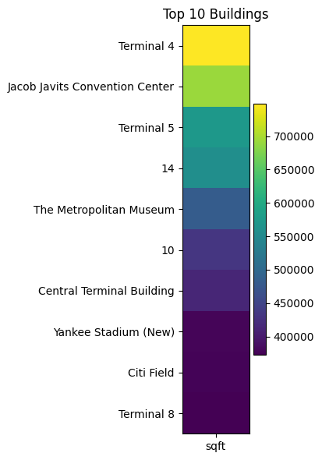
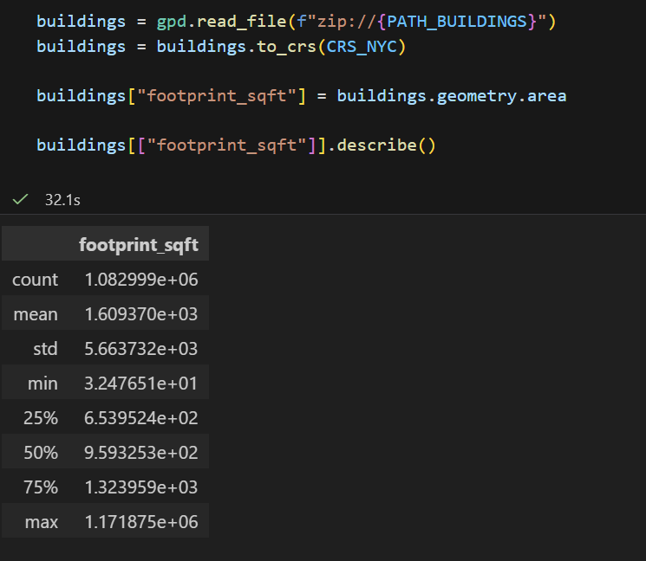
UNDERSTANDING the Data
Using Geopands, aggregated the footprint square feet of buildings

Slide 5
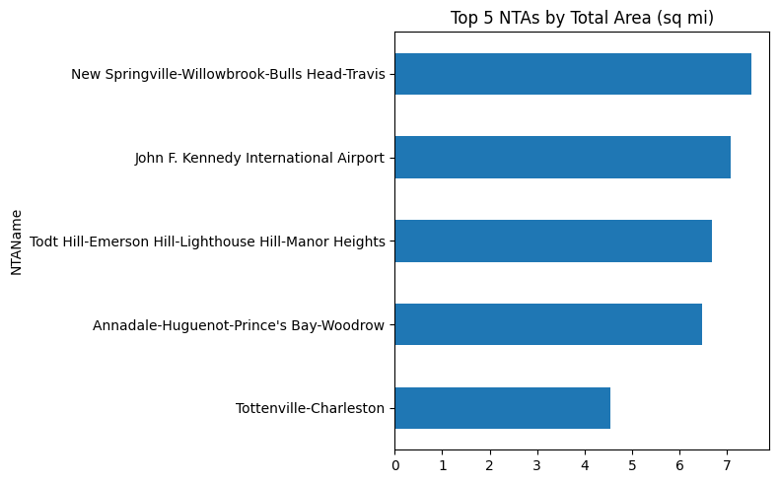
UNDERSTANDING the Data
NTA Total Area is the Square Mile size of the neighborhood

Slide 6
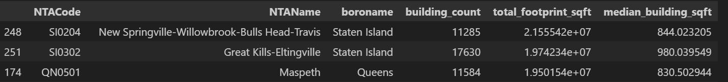
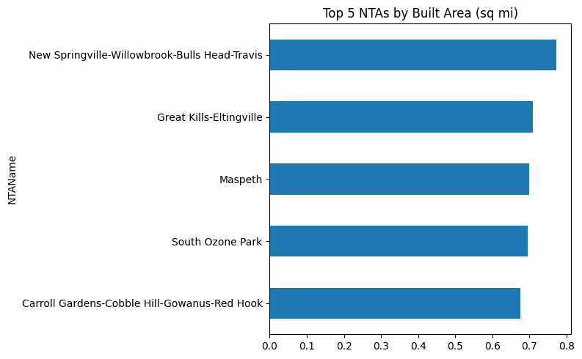
ENRICHING the Data
NTAs by Built Area is the total footprint of buildings that intersect the shape of the NTA

Slide 7
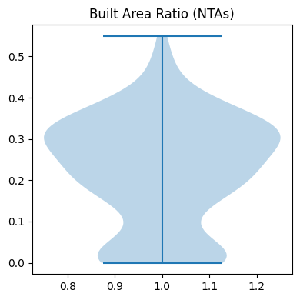
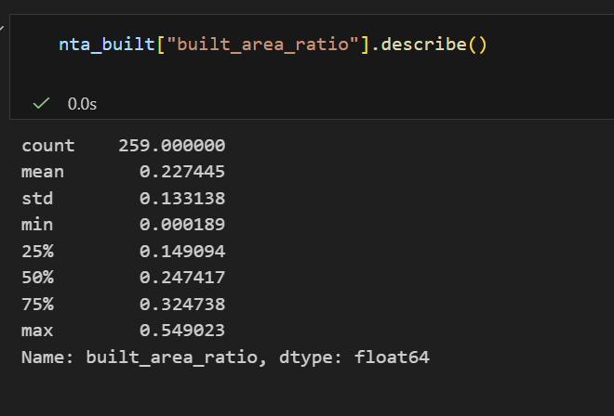
ENRICHING the Data
Built Area Ratio = Building Foot Print / NTA Area

Slide 8
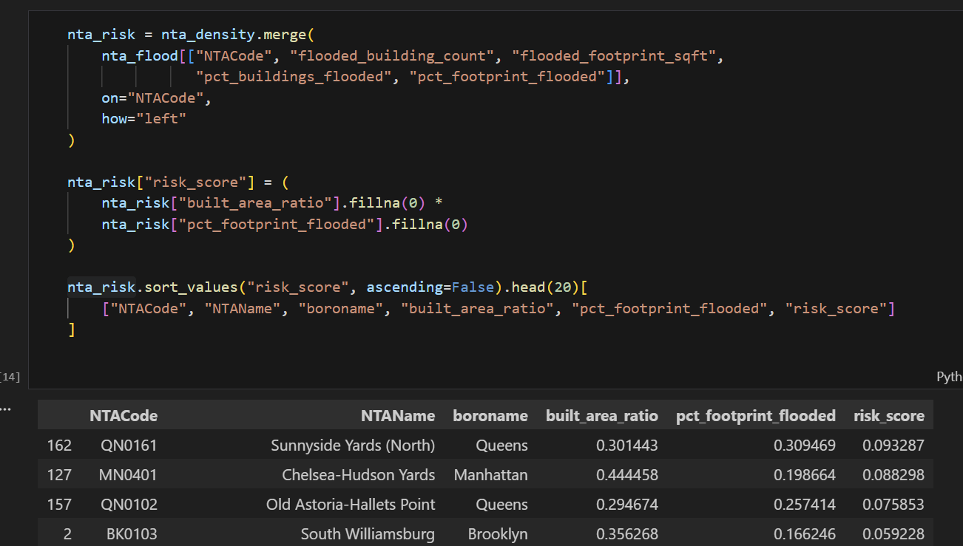
Enriching the Data
Created a risk score for NTA level, combining density with total area effected by floods
Processed new joined datasets into parquet files for downstream consumption

Slide 9
ENRICHING THE DATA
NTA Code | NTA Name | Borough | Built Area Ratio | Prct Foot Print Flooded | Risk Score
QN0161 | Sunnyside Yards (North) | Queens | 0.301443 | 0.309469 | 0.093287
MN0401 | Chelsea-Hudson Yards | Manhattan | 0.444458 | 0.198664 | 0.088298
QN0102 | Old Astoria-Hallets Point | Queens | 0.294674 | 0.257414 | 0.075853
K0103 | South Williamsburg | Brooklyn | 0.356268 | 0.166246 | 0.059228
QN1201 | Jamaica | Queens | 0.3134 | 0.116817 | 0.03661
MN0601 | Stuyvesant Town-Peter Cooper Village | Manhattan | 0.205679 | 0.177853 | 0.036581
QN0601 | Rego Park | Queens | 0.275499 | 0.129549 | 0.035691
BX0502 | Mount Hope | Bronx | 0.351019 | 0.097271 | 0.034144
QN0401 | Elmhurst | Queens | 0.328939 | 0.098904 | 0.032533
MN0203 | West Village | Manhattan | 0.416286 | 0.073578 | 0.03063
MN0402 | Hell's Kitchen | Manhattan | 0.475031 | 0.062336 | 0.029612
QN0501 | Maspeth | Queens | 0.33442 | 0.087927 | 0.029405
MN0701 | Upper West Side-Lincoln Square | Manhattan | 0.38747 | 0.075419 | 0.029223
BK0102 | Williamsburg | Brooklyn | 0.359665 | 0.081145 | 0.029185
BX1161 | Hutchinson Metro Center | Bronx | 0.150508 | 0.188473 | 0.028367
QN0202 | Sunnyside | Queens | 0.303371 | 0.092197 | 0.02797

Slide 10
ENRICHING THE DATA
NTA Code | NTA Name | Borough | Built Area Ratio | Prct Foot Print Flooded | Risk Score
QN0161 | Sunnyside Yards (North) | Queens | 0.301443 | 0.309469 | 0.093287
MN0401 | Chelsea-Hudson Yards | Manhattan | 0.444458 | 0.198664 | 0.088298
QN0102 | Old Astoria-Hallets Point | Queens | 0.294674 | 0.257414 | 0.075853
K0103 | South Williamsburg | Brooklyn | 0.356268 | 0.166246 | 0.059228
QN1201 | Jamaica | Queens | 0.3134 | 0.116817 | 0.03661
MN0601 | Stuyvesant Town-Peter Cooper Village | Manhattan | 0.205679 | 0.177853 | 0.036581
QN0601 | Rego Park | Queens | 0.275499 | 0.129549 | 0.035691
BX0502 | Mount Hope | Bronx | 0.351019 | 0.097271 | 0.034144
QN0401 | Elmhurst | Queens | 0.328939 | 0.098904 | 0.032533
MN0203 | West Village | Manhattan | 0.416286 | 0.073578 | 0.03063
MN0402 | Hell's Kitchen | Manhattan | 0.475031 | 0.062336 | 0.029612
QN0501 | Maspeth | Queens | 0.33442 | 0.087927 | 0.029405
MN0701 | Upper West Side-Lincoln Square | Manhattan | 0.38747 | 0.075419 | 0.029223
BK0102 | Williamsburg | Brooklyn | 0.359665 | 0.081145 | 0.029185
BX1161 | Hutchinson Metro Center | Bronx | 0.150508 | 0.188473 | 0.028367
QN0202 | Sunnyside | Queens | 0.303371 | 0.092197 | 0.02797
X =

Slide 11
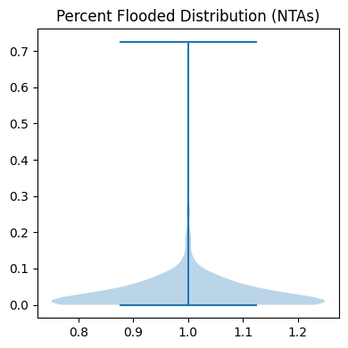
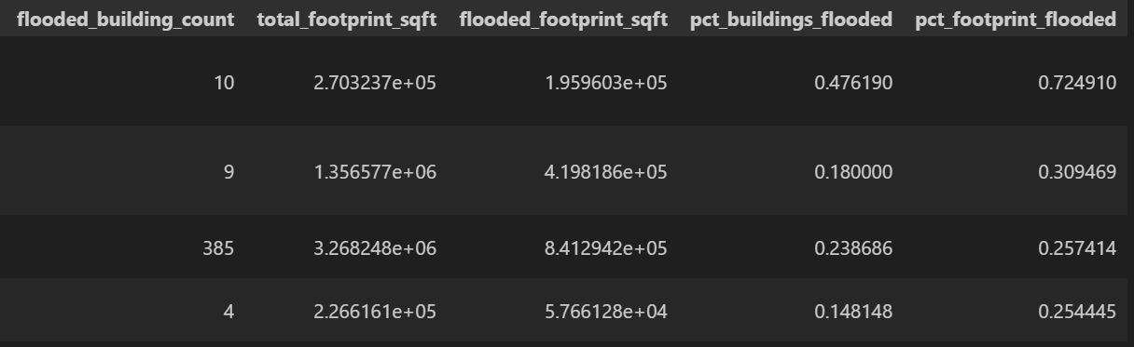
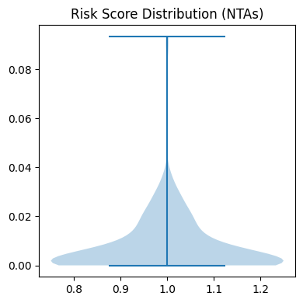
Enriching the Data
Mapped in flag for is_flooded to get the total square feet of flooded zones, their percentages buildings flooded, and % footprint flooded

Slide 12
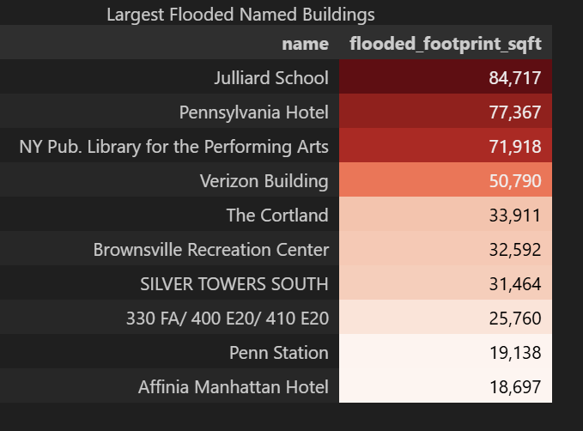
Findings and Visualizations

Slide 13
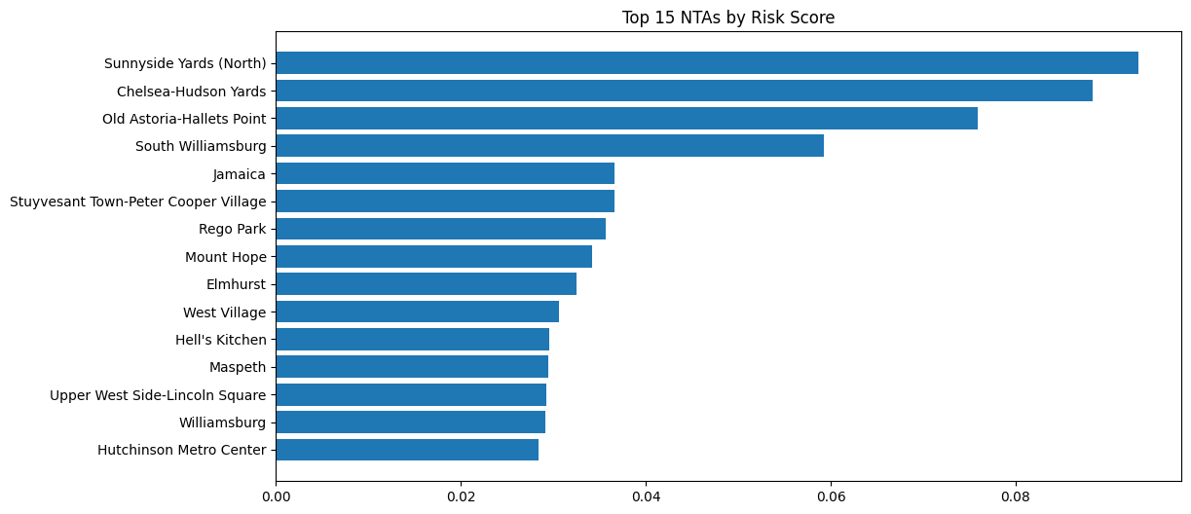
Findings and Visualizations

Slide 14
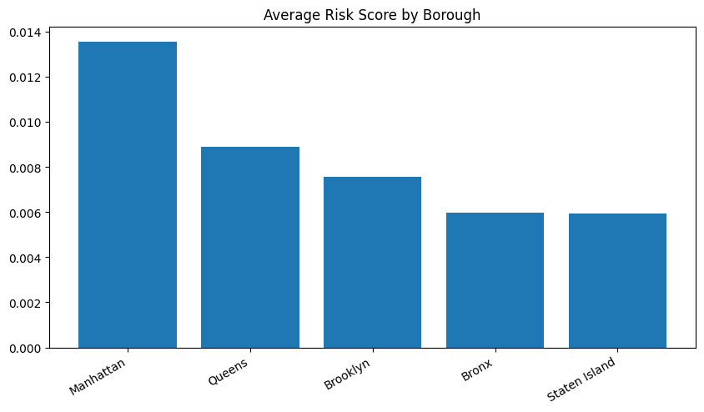
Findings and Visualizations

Slide 15
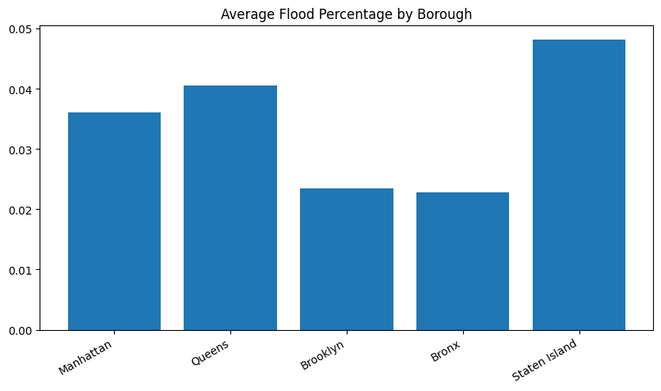
Findings and Visualizations

Slide 16
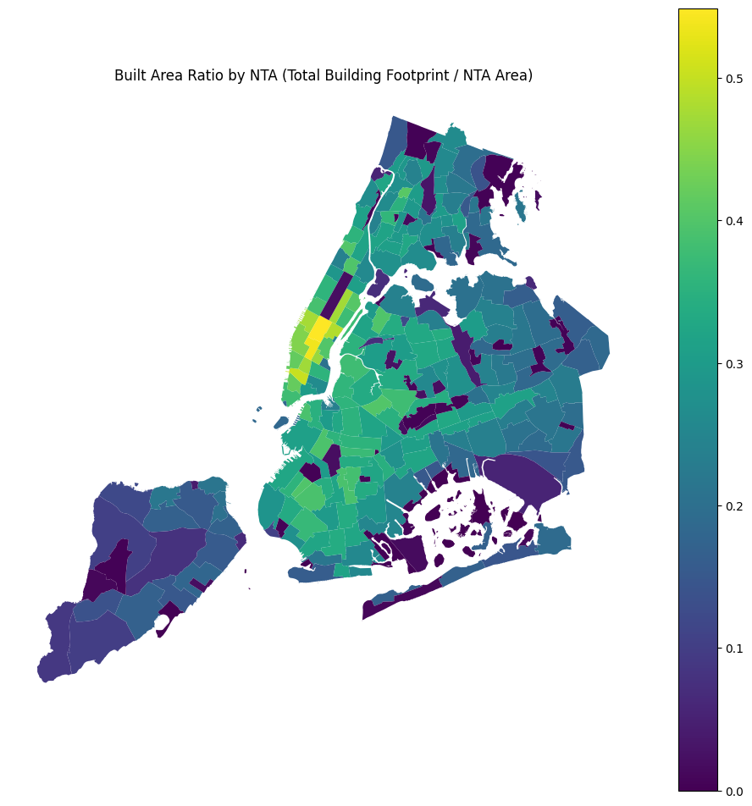
Findings and Visualizations

Slide 17
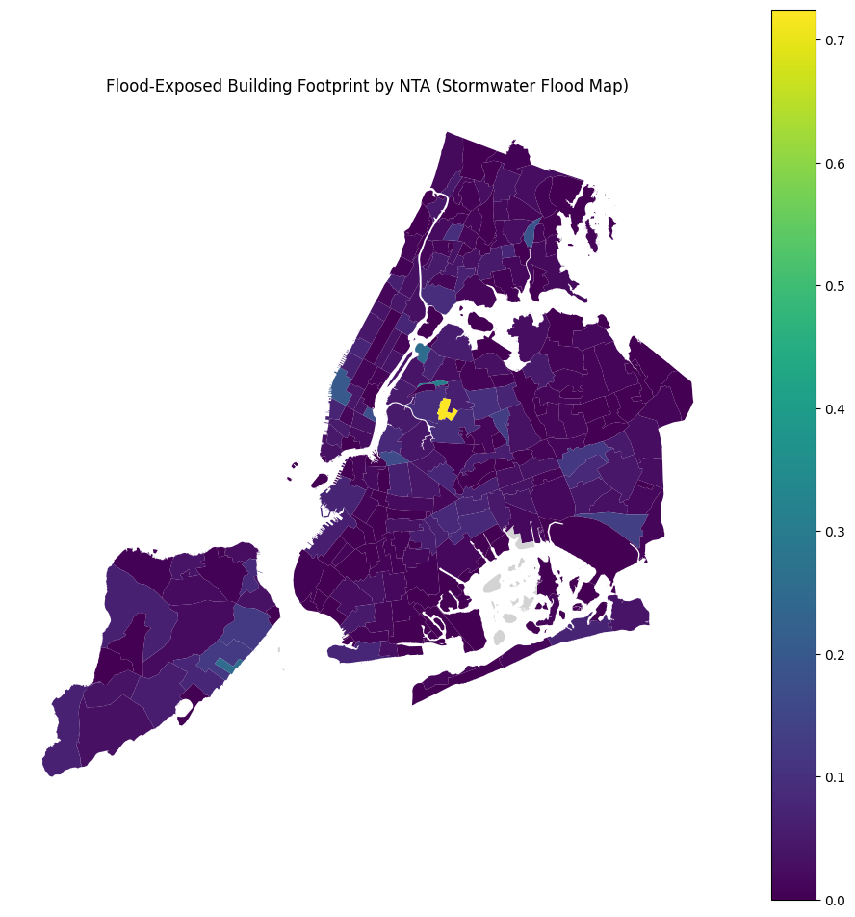
Findings and Visualizations
Notes:
Shows Calvary and Mount Zion Cemetaries in Queens has a high flooded building footprint percentage, but its built area ratio is very low (2.5%)

Slide 18
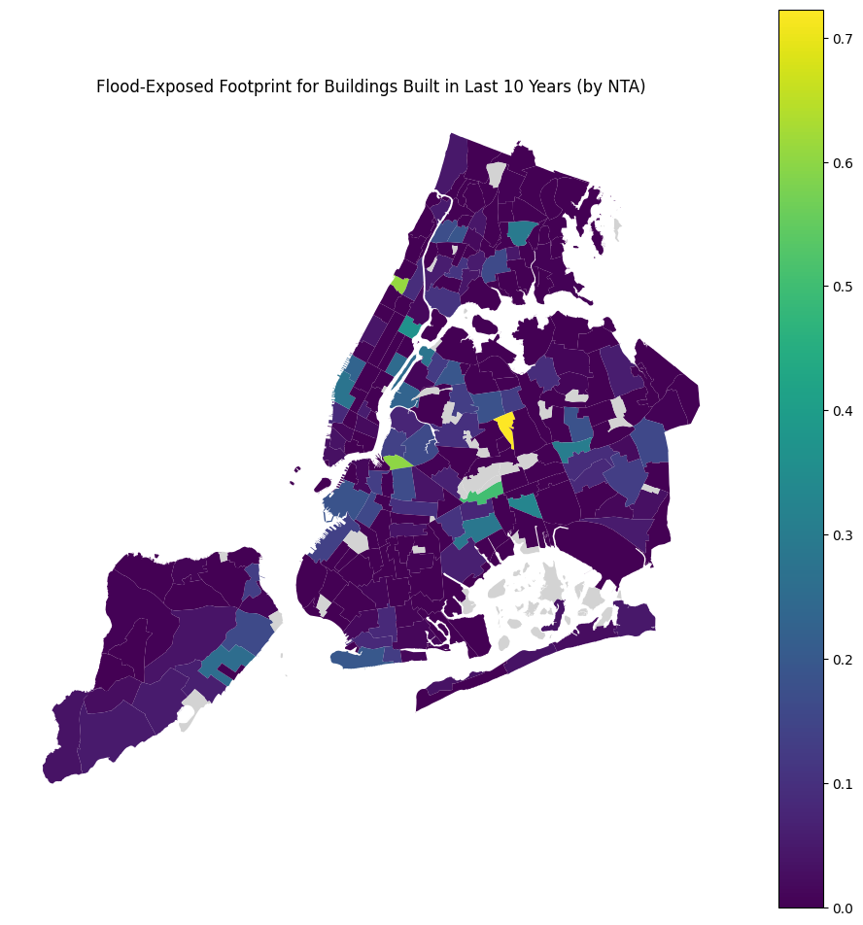
Findings and Visualizations

Slide 19
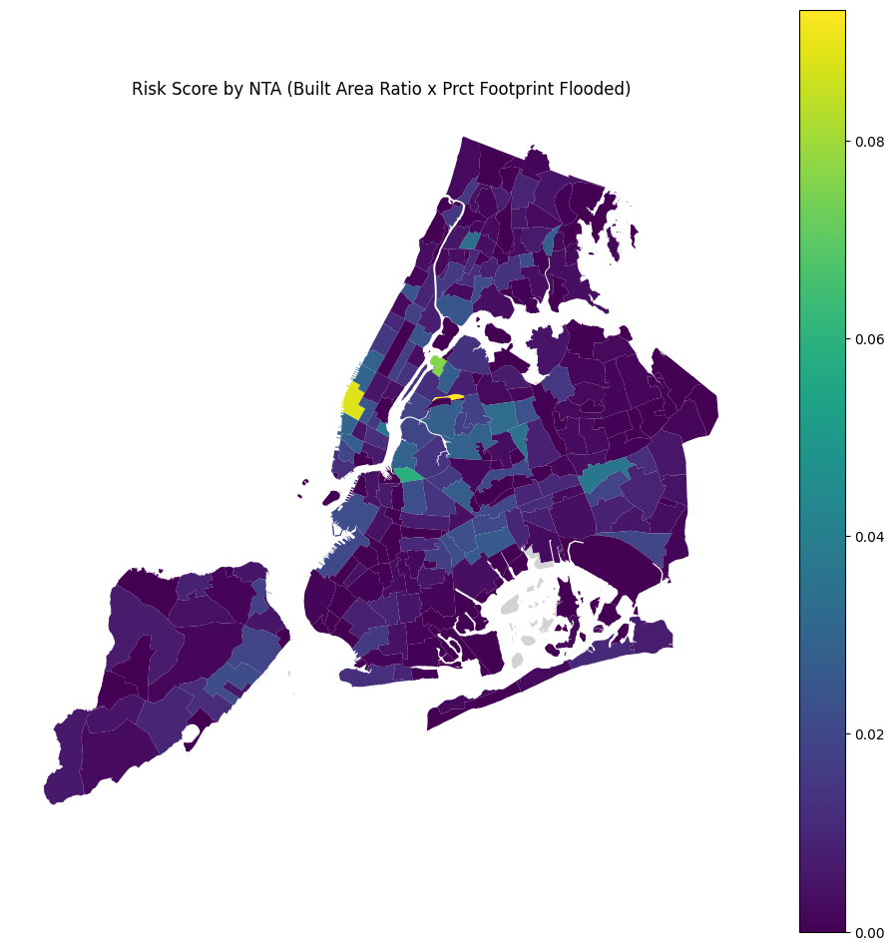
Findings and Visualizations

Slide 20
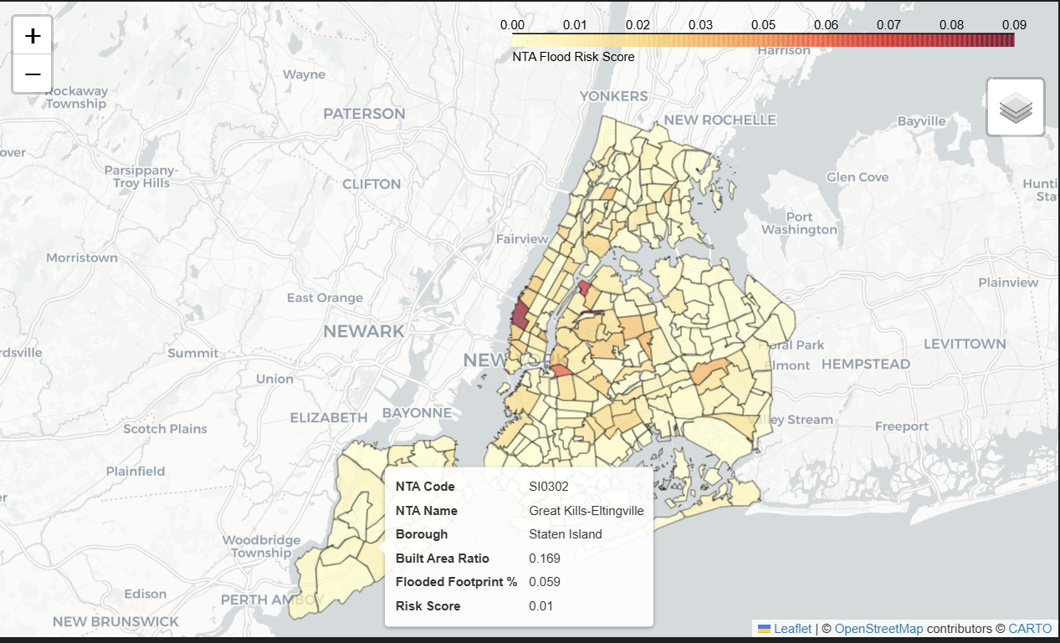
Findings and Visualizations

Slide 21
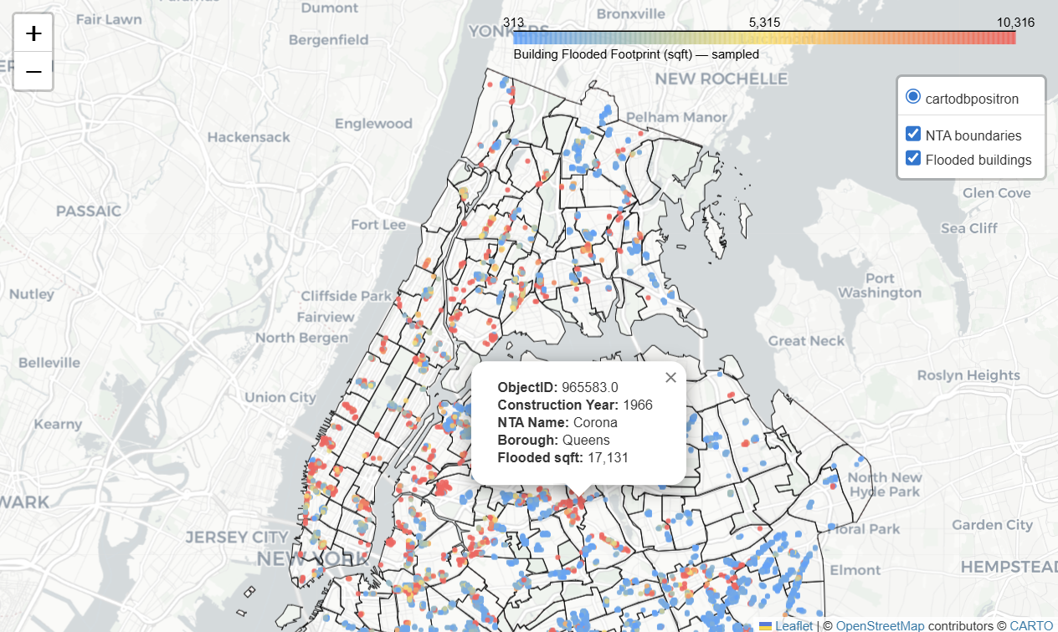
Findings and Visualizations

Slide 22
Who Cares?
This sort of data set can pique the interests of many industries and services
Flood insurance companies looking to locate at risk buildings in need of policy updates
City government looking to target neighborhoods that require updates to their flood defense systems
Real estate companies looking to loop in the risk of floods and its effects on the long term of their portfolios

Slide 23
Engaging the Data – Hiccups to pivot
Initial goal was to loop in historical data, but re-naming of NYC’s Neighborhood Tabulation Areas (NTAs) codes made this difficult, the data does exist without a request process from NYC.gov
Upon further exploration other sources of data only yielded the historical decommissioning of buildings, the goal to highlight ‘recent areas of interest’ would need to be left out
Construction Year column allowed for a decent pivot so that we could at least highlight this in some cases

Slide 24
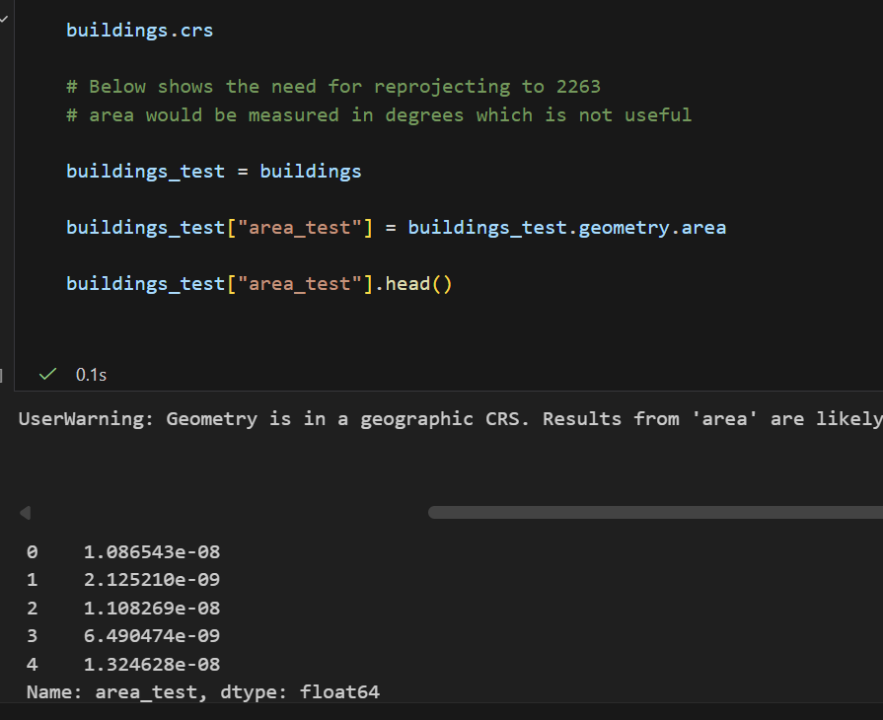
Engaging the Data – Hiccups and Learning
Coordinate Reference System (CRS)
Some of the geospatial datasets were in ESPG 4326 which is a global latitudinal/longitudinal CRS and most common in world
Note the e-08 etc tiny measurements in degrees
EPSG 2263 is specific to New York and allows for area computation
“Flat” and feet-based, allows for density, length, area, etc.
CRS should always be a first step in checking a geospatial dataset
Notes:
This is where we went from 3 disparate datasets to one functioning dataset – Explain the centroid join with the predicate of within to allow for joining center points to WITHIN the geometrical shape of a neighborhood

Slide 25
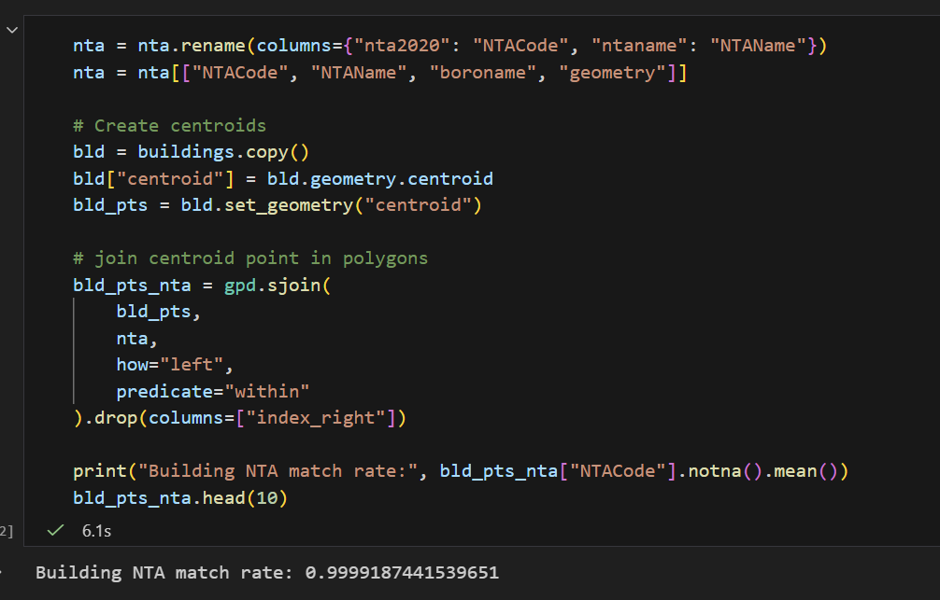
Engaging the Data
Combining all 3 datasets requires finesse
Taking the centroid of the polygon shapes of building and joining them to polygon shapes of NTAs allowed us to state where these buildings belonged
Flood zones followed a similar process
Confirmation done to ensure joins worked
Processed new joined datasets into parquet files
Notes:
This is where we went from 3 disparate datasets to one functioning dataset – Explain the centroid join with the predicate of within to allow for joining center points to WITHIN the geometrical shape of a neighborhood

Slide 26
Future Direction
Bring in a more sophisticated flood model
Options such as various rain severities, or even NYC labeled flood events based on vulnerability (New York City's Flood Vulnerability Index | NYC Open Data)
Zoning and other government filings to create new structures
Regular updates with new construction, could be used to alert an insurance company of new major construction in an area they want to sell policies to
Real Estate Value vs Risk Model
Combine rising costs of neighborhoods to rising risk to quantify risk in $$$
Utilizing PMTiles files to overlay various polygonal shapes and create a more interactive dashboard type feel by tying in HTML

Slide 27
Sources and Links
Building Footprints (Map) | NYC Open Data
2020 Neighborhood Tabulation Areas (NTAs) | NYC Open Data
NYC Stormwater Flood Maps | NYC Open Data
www.powervisualize.com
rowens2025

Slide 28
Thank you
Ryan Owens

